Slide 1


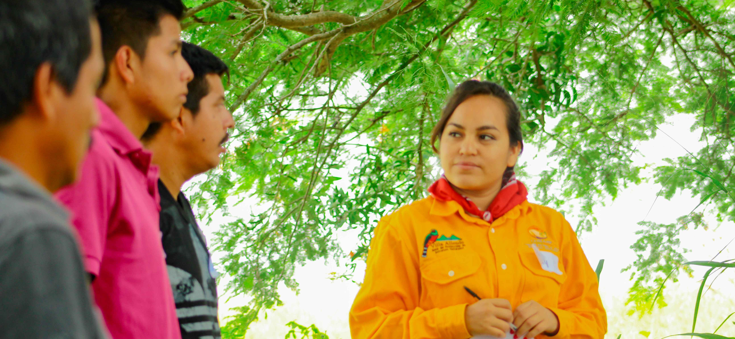
People of Parks
Inspire love of nature
WWW.natureforall.global/people-of-parks
The campaign
Inspiring Others
In celebration of IUCN World Commission on Protected Areas 60th Anniversary, and through the IUCN #NatureForAll People of the Parks video campaign, park staff, such as rangers, wardens, interpreters, guides, etc., share their love of parks and protected areas with broader audiences through short, personal videos.
Through #NatureForAll, these videos will be used to highlight the amazing conservation work happening worldwide, and to encourage members of the public to share their love of nature videos. A number of park staff from around the world have already shared their video stories.
Employees of parks and protected areas are at the forefront of protecting nature. Their roles are essential to conserving biodiversity and delivering diverse benefits for people and the planet.
Every day, they work to safeguard habitat for wildlife and educate others about the importance of nature.
Their work is essential for the effective management of wild, historical and culturally significant places, and meeting global goals for sustainable development and biodiversity conservation.
The more people experience and share their love of nature, the more support and action there will be for its conservation. We can play an important part in inspiring others by sharing our own stories of love and connection with nature.
This is my story and my effort to connect people with nature.
Voici mon histoire et ce que je fais pour créer un lien entre les gens et la nature.
Esta es mi historia y mi esfuerzo por conectar a la gente con la naturaleza
How to share your story with #NatureForAll
Answer one of the following questions:
Option 1: Why do you love nature?
Option 2: Why do you love your park/protected area?
Option 3: How does your work help you connect with nature?
Option 4: What was your first connection to nature?
Include
your name
the organisation you work with
Where are you filming
Keep it to no longer than 30 seconds maximum.
Film it in horizontal format.
Record it with the “selfie” mode on your phone.
Record it in the language of your choice.
Share it on social media and tag #NatureForAll
Email it to info@natureforall.global

