Slide 1

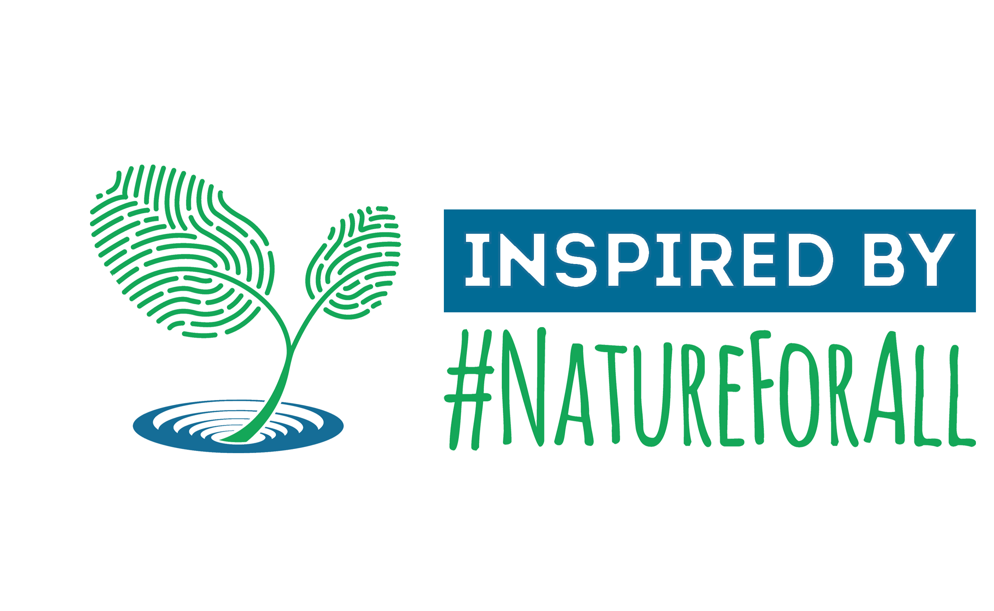



Sounds of Your Park
Meditate to natural and cultural sounds from around the globe
WWW.SOUNDSOFYOURPARK.COM
What is ‘Sounds of Your Park’?
Global Sound Map Statistics
The ‘Sounds of Your Park’ initiative is a continuously growing collection of sounds intended to celebrate the acoustical beauty and diversity of the world’s national parks and other protected areas.
Through this immersive platform, you can enjoy nature and cultural sounds from around the world, in the comfort of your home.
Natural spaces, species, and traditional cultural practices are disappearing around the globe as the modern human footprint expands. Coupled with this is the associated loss of natural and cultural soundscapes. Stated plainly, some of the planet’s most iconic sounds are disappearing and are now largely confined to the most isolated and protected places.
Natural sounds in particular are shown to benefit human health and can indicate the health of ecosystems. Having access to these places and their sounds, either directly or through remote listening opportunities like ‘Sounds of Your Park’, helps restore human well-being and ecosystem health and in turn, raises awareness of these critically important places.
120 sounds & growing
> 40 protected areas
16 countries represented
15,000 listeners & counting
Natural sounds aid conservation
Natural Sounds Benefit People
Joint initiative
By recording these sounds, conservationists can learn more about ecosystems, the behaviours of wildlife, and the impact humans have on nature. Through sounds, scientists can listen to how species communicate and move, and how they might response to climate change and human-caused disturbances, like overflights or marine traffic.
‘Sounds of Your Park’ raises awareness of represented protected areas, aiding in their protection.
Research shows that listening to natural sounds can have a positive impact on both physical and psychological well-being.
In addition, providing an online platform increases accessibility to nature for those who don't have the physical, financial, and time capabilities.
Health benefits include:
Pain reduction
Enhanced mood
Stress relief
Increased cognitive performance
Faster recovery after stressful events
Inspired by #NatureForAll, ‘Sounds Of Your Park’ is a joint initiative between:
The IUCN World Commission on Protected Areas
The George Wright Society
The U.S. National Park Service
Parks Canada
Colorado State University's Sound and Light Ecology Team.

