Slide 1
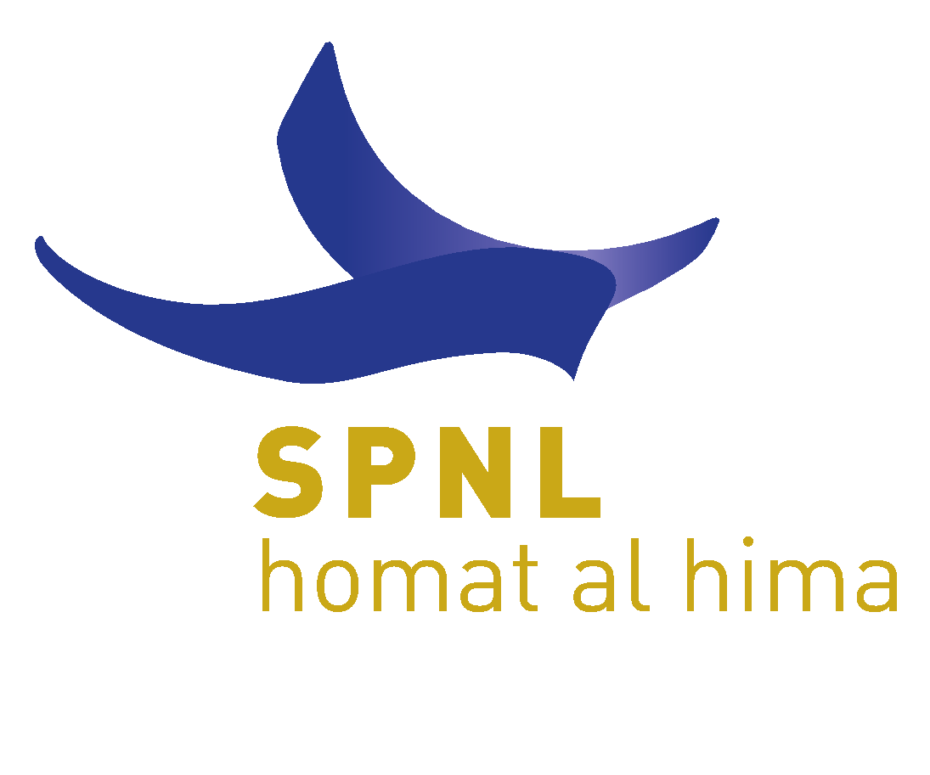
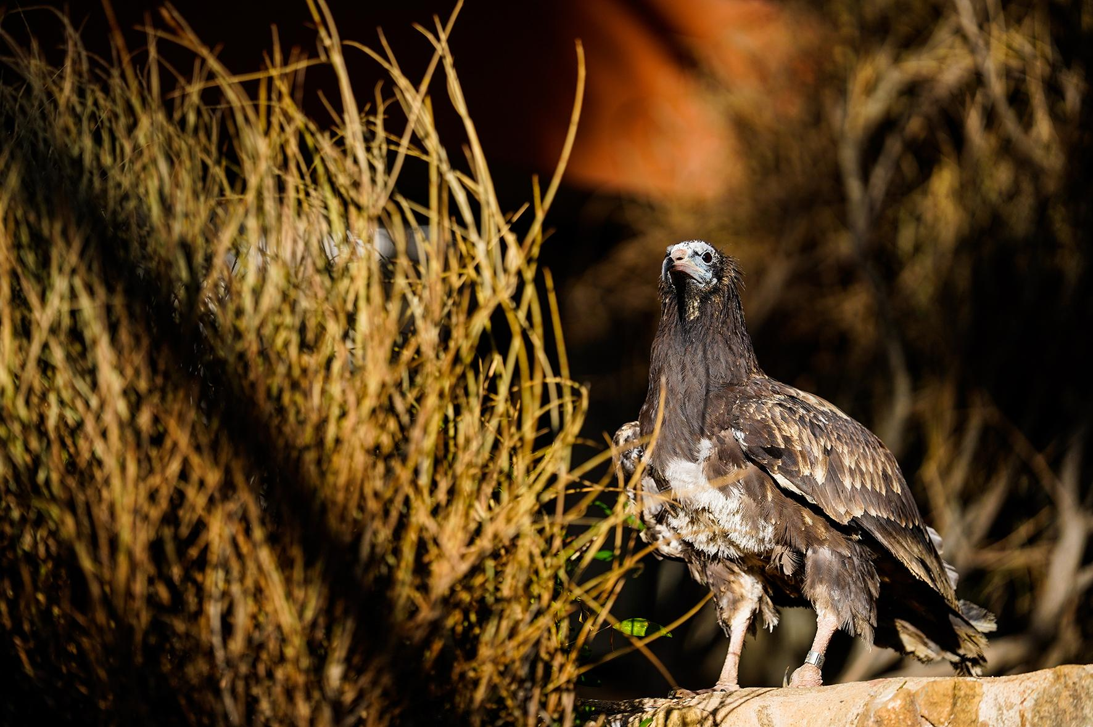
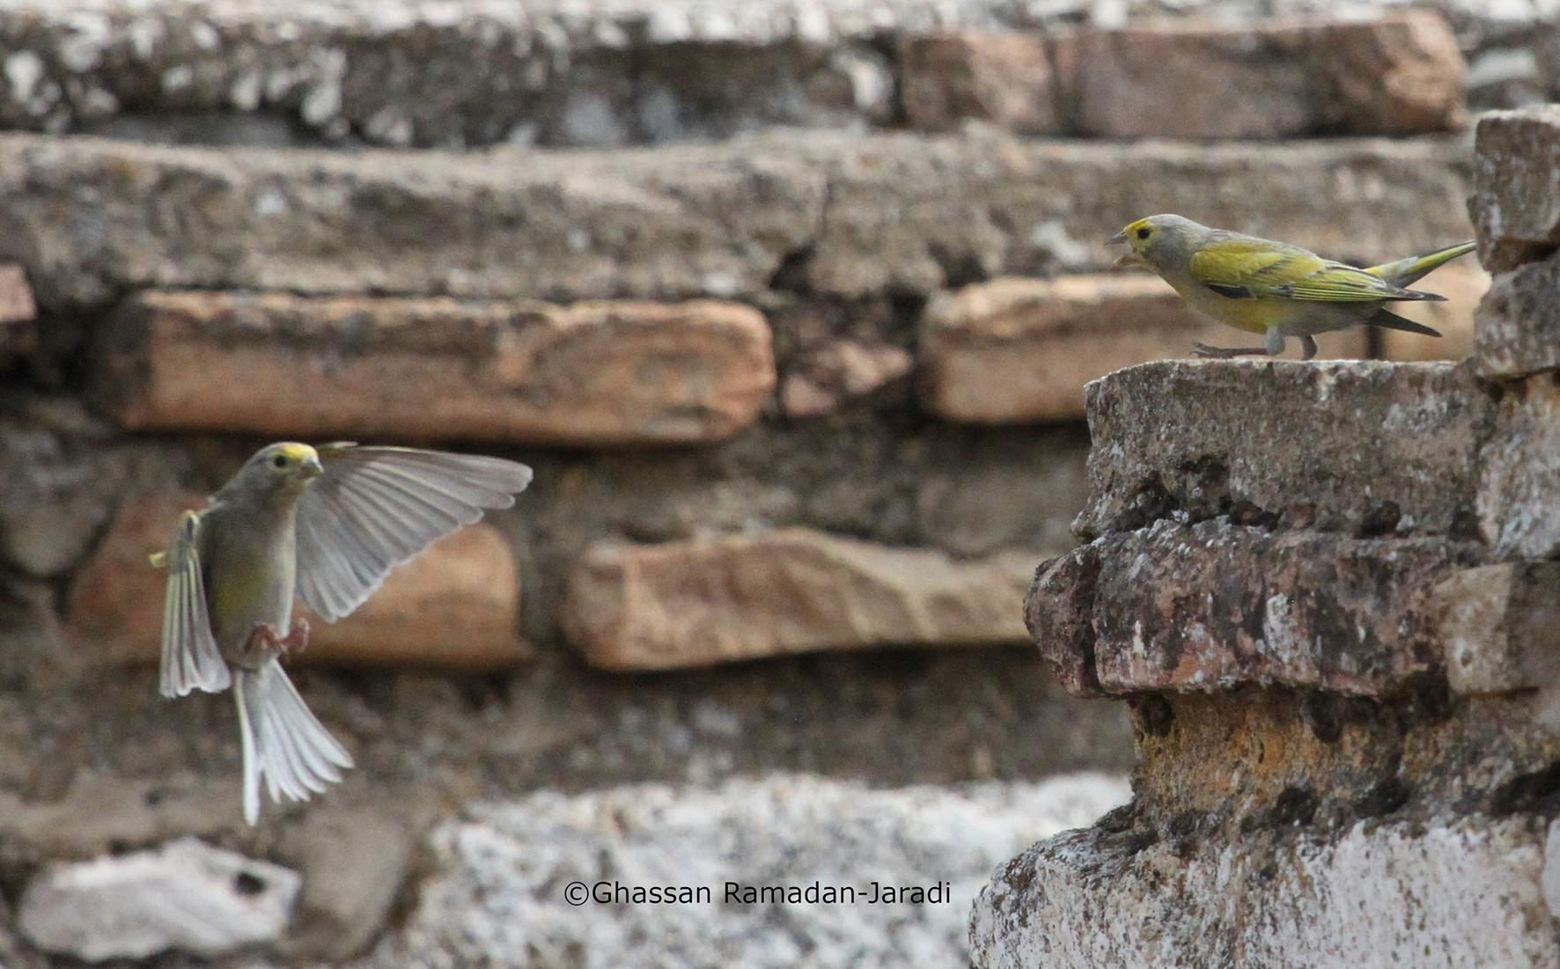
ANAHITA | A STORY OF HOPE
HIMA FOR PEACE
Alice Al Baghdadi | Elie El Haddad | Jamal Hamzeh | Rania Khalil | Assad Serhal
Society for the Protection of Nature in Lebanon | IUCN West Asia
AL HIMA | A WAY OF LIFE
AL HIMA | A SUSTAINABLE MODEL
Al Hima, protected place in Arabic, is a ancient traditional system of resource tenure that has originated in the Arabian Peninsula. Deeply rooted in communities’ collective memory as a way of life, Al Hima was revitalized by SPNL in 2004 as a community based approach to conserve ecologically valuable landscapes and ecosystems. In 2019, it got endorsed as 4th category to the protected areas of Lebanon, supplementing State Protected Areas. A total of 25 Hima community based protected areas exist up until 2021 and cover around 6% of the Lebanese territory. Energizing Hima Revival, SPNL and IUCN ROWA have been joining efforts to explore the potential for Hima to build peace and reconciliation between neighboring families, communities and countries in the upcoming 2022 regional Hima workshop.
Through the Hima holistic approach, SPNL has built a socially, environmentally, and economically sustainable model, addressing various conservational and societal challenges in Lebanon. While protecting highly significant ecological and cultural sites, the Hima bottom-up cooperative and inclusive approach enables local communities to develop leadership in decision making, promotes education and capacity building, diversifies local economy, enhances policy changes and strengthens traditional knowledge within local culture, while empowering marginalized groups including women and youth. Further, the Hima enhances communities’ ability to adapt and respond to environmental, social and economic change, ensuring their resilience in the face of external pressures, especially in the context of the Climate Emergency.
Anahita at Luc Hoffmann Hima Center aviary
S. SYRIACUS | A DEVOTED JOURNEY
Two Syrian Serin males in their natural habitat at Hima Anjar
Illegal Killing of Birds is a major threat to migratory birds in Lebanon. SPNL works closely with diverse partners, Internal Security Forces and responsible hunters to monitor violations. This has exemplified in the recent rescue of an injured juvenile Egyptian Vulture, Anahita, brutally shot on her journey from the Balkans to Africa. She was reared by SPNL team at LHHC aviary and returned back to Bulgaria (BSPB).
SPNL is committed to conserving and protecting the Syrian Serin, a regionally endemic species under great threat in its current range. National and Regional action planning would enable conservation action for this vulnerable species through raising its value among local communities, conserving its populations and habitats, as well as planning for a captive breeding and releasing program in our Himas.

